Slide 1
Holo-RAG: Recovering Lost Reality Through AI

Slide 2
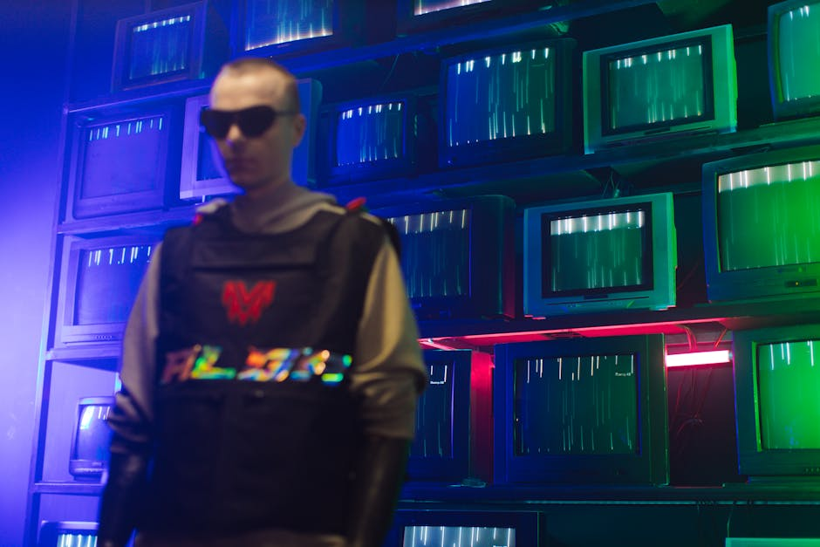
The Hook: The Lost Reality
The Challenge: The Phase Problem
In physics, the 'Phase Problem' occurs when we can measure only intensity, not phase, leading to incomplete images at the micro-scale. It’s like seeing static instead of structure.
Why It Matters
Without phase data, microchip analysis, material imaging, and holography fail to show real-world accuracy.
The Vision
Imagine if AI could restore that lost phase—revealing the hidden structures of our physical world.

Slide 3
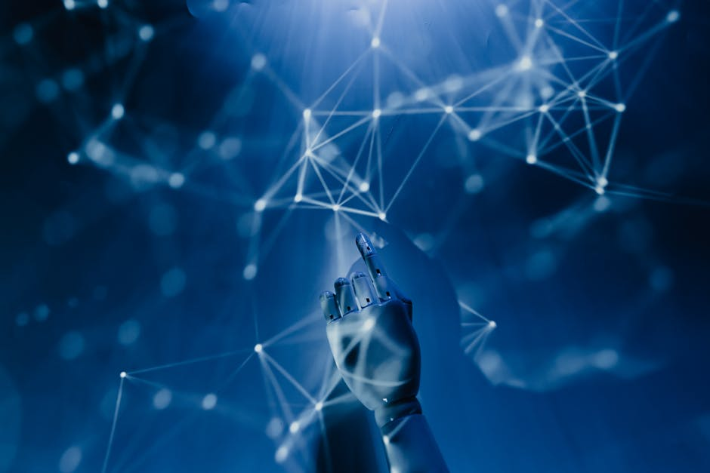
The Solution: Holo-RAG Pipeline
Physics Meets AI
Holo-RAG integrates a custom U-Net with a physics-based model to reconstruct holographic data in real time. It bridges physics and generative AI.
How It Works
Raw holographic data is fed into the U-Net, which learns to reverse the Fourier Transform and recover lost phase information.
Impact
This pipeline enables clear, accurate reconstructions of microscopic structures—turning noise into knowledge.

Slide 4
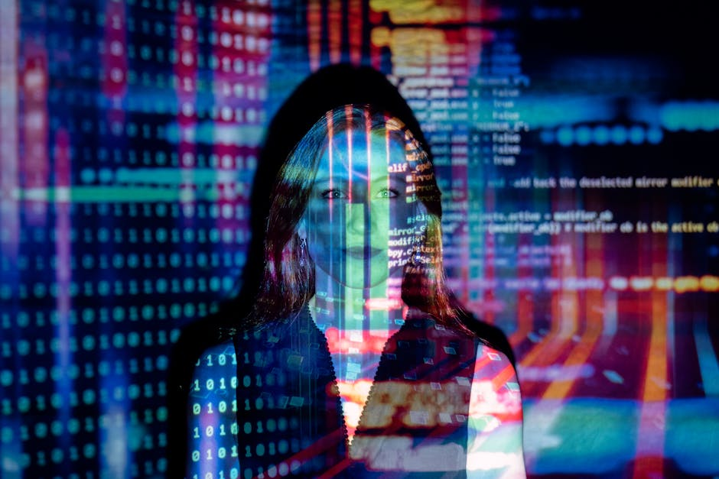
AI Inverting Physics
The Demo
The AI model takes noisy holographic inputs and reconstructs crisp, clear images in real-time, effectively inverting physical processes.
The Proof
Input: chaotic interference patterns. Output: precise reconstruction of the object.
The Breakthrough
This proves that AI can learn the physics of diffraction and inversion, not just data patterns.

Slide 5

The RAG Connection
Beyond Reconstruction
Once the object is reconstructed, Holo-RAG links it to relevant technical knowledge using Retrieval-Augmented Generation (RAG).
Multimodal RAG
This system doesn’t just see—it understands. Visual data becomes a query to fetch text-based knowledge from scientific databases.
Fusion of Physics and AI
By combining physical reality and semantic knowledge, Holo-RAG bridges the gap between perception and understanding.

Slide 6
Bringing Generative AI to the Hard Sciences
What’s Next for Physics-Informed AI?
Conclusion: The Future of Holo-RAG
Holo-RAG demonstrates that AI can recover lost physical information and fuse it with knowledge retrieval. This is the next step in merging data-driven and physics-based intelligence.

